Slide 1
Progress Report
OF
INDUSTRIAL TRAINING (22CA029)
UNDERTAKEN
AT
BEBO Technologies
ON
Selenium Testing of ODOO Website
SUBMITTED IN PARTIAL FULFILLMENT OF THE DEGREE
OF
Master of Computer Applications (MCA)
Submitted By:
Name: Amar Arora
College Roll No.: 2310987016
Department: Computer Application

Slide 2
Introduction of Company
Bebo Technologies is a premier software solutions provider renowned for delivering top-notch software development, testing, and support services. With expertise in technologies like Python, Selenium, JMeter, and more, Bebo Technologies offers innovative and scalable IT solutions. The company is distinguished by its commitment to quality, collaboration, and customer satisfaction, serving clients across diverse industries and empowering their digital transformation and success.

Slide 3
Manual Testing
1. Manual Testing
Manual testing is a core software testing method where a tester manually executes test cases without relying on automated tools. This approach is essential for evaluating an application's functionality, usability, and overall quality from an end-user perspective.
Types of Manual Testing:
Functional Testing:
  Validates that the software’s features and functionalities perform as intended based on requirements. This includes testing user interactions, workflows, and business logic..
Integration Testing:
  Ensures that integrated modules interact correctly and that data flows seamlessly between components..
System Testing:
  Tests the entire application to verify it meets specified requirements. It focuses on complete end-to-end scenarios, including workflows and integrations..

Slide 4
Manual Testing
User Acceptance Testing (UAT):
Conducted by end-users or clients to verify that the application meets business requirements. Ensures the system is ready for deployment in the live environment.
Regression Testing:
Retests the application after changes, such as bug fixes or feature updates, to ensure no existing functionalities are broken.
Exploratory Testing:
Performed without predefined test cases, focusing on discovering defects through exploration and creativity. Useful when requirements are unclear or incomplete.
Sanity Testing:
Conducted to verify that new features or fixes work as expected before proceeding with more detailed testing.

Slide 5
Manual Testing
Smoke Testing:
A preliminary test to check if the major functionalities of the application are working and whether it is stable enough for further testing.
Usability Testing:
Assesses the application's user-friendliness, ensuring an intuitive and seamless user experience.
Compatibility Testing:
Ensures the application works across different browsers, devices, operating systems, and network environments.
Performance Testing (Manual):
  Measures application response time, reliability, and stability under varying conditions without automation tools.
Localization and Internationalization Testing:
Verifies that the application is adapted for specific languages, regions, and cultural contexts. Checks global readiness by supporting multiple languages and formats

Slide 6
Why Choose Python?
Beginner-Friendly Syntax: Python features a clean and straightforward syntax that closely resembles plain English .
Community Support: A vast and active community ensures continuous updates, support, and resources.
Rich Ecosystem of Libraries and Frameworks: Python boasts a comprehensive ecosystem of libraries such as Pandas, Pytest.

Slide 7
Introduction
Odoo HRM is a comprehensive human resource management system designed to streamline and automate HR processes. It provides an integrated solution for managing employee information, recruitment, attendance, all within a single platform.
This project utilizes testing techniques with Selenium and Python to ensure the reliability and functionality of Odoo HRM's core features, improving overall efficiency and accuracy in HR operations..

Slide 8
Setting Up Selenium with Python
Installed Python and Selenium.
Set up ChromeDriver or any browser Driver for browser automation.
Used Python scripts to automate login testing.

Slide 9
Locating Elements
Used locators to find elements:
By.NAME for E-mail and password fields.
By.XPATH for the login button and Discuss Module verification.
Examples:
driver.find_element(By.NAME, “e-mail")
driver.find_element(By.XPATH, "//button[@type='submit']")

Slide 10
Performing Actions
Actions performed:
Entering E-mail and Password.
Clicking the login button.
Verifying the Discuss board.
Code snippet:
textbox1 = driver.find_element(By.NAME, “Login")
textbox1.send_keys(“a33131678@gmail.com")
textbox2 = driver.find_element(By.NAME, "password")
textbox2.send_keys(“ProjectOdoo118")
click = driver.find_element(By.XPATH, “//button[@type=‘submit’]”)
click.click()

Slide 11
Test Cases and Scenarios
Test case: Validate login functionality with correct credentials.
Expected result: Successful navigation to the Discuss Module.
Code for validation:
expected = "Discuss“ Module
act = driver.find_element(By.XPATH, "//h6[@class='o-dropdown-item dropdown-item o-navigable o_menu_brand d-flex']").text
if expected == act:
print("test case pass")
else:
print("test case fail")

Slide 12
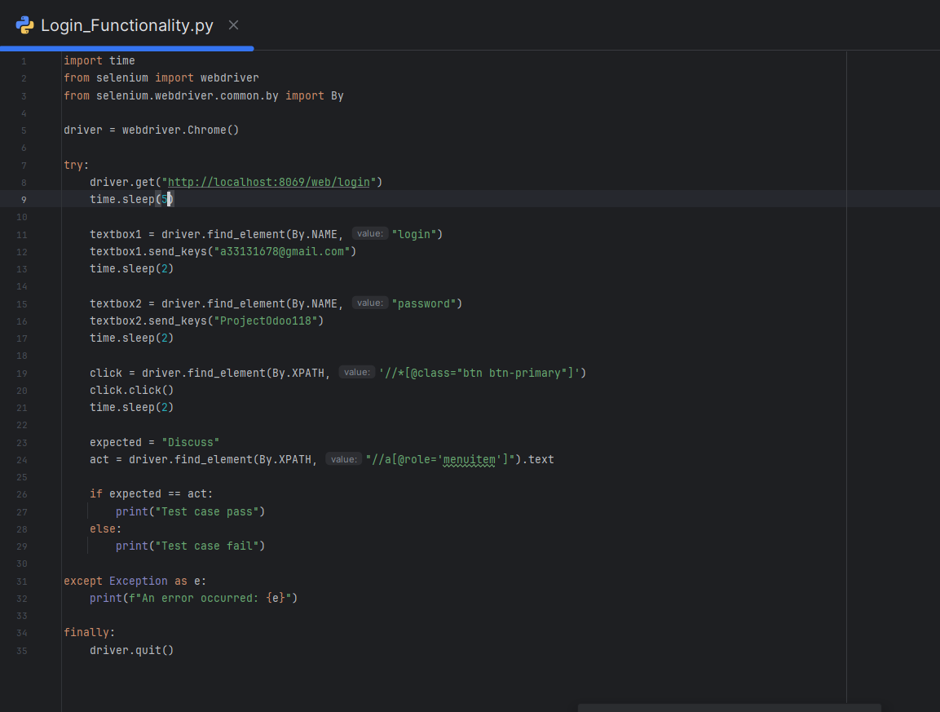
Screenshots of Command
Login Page Code before entering credentials.

Slide 13
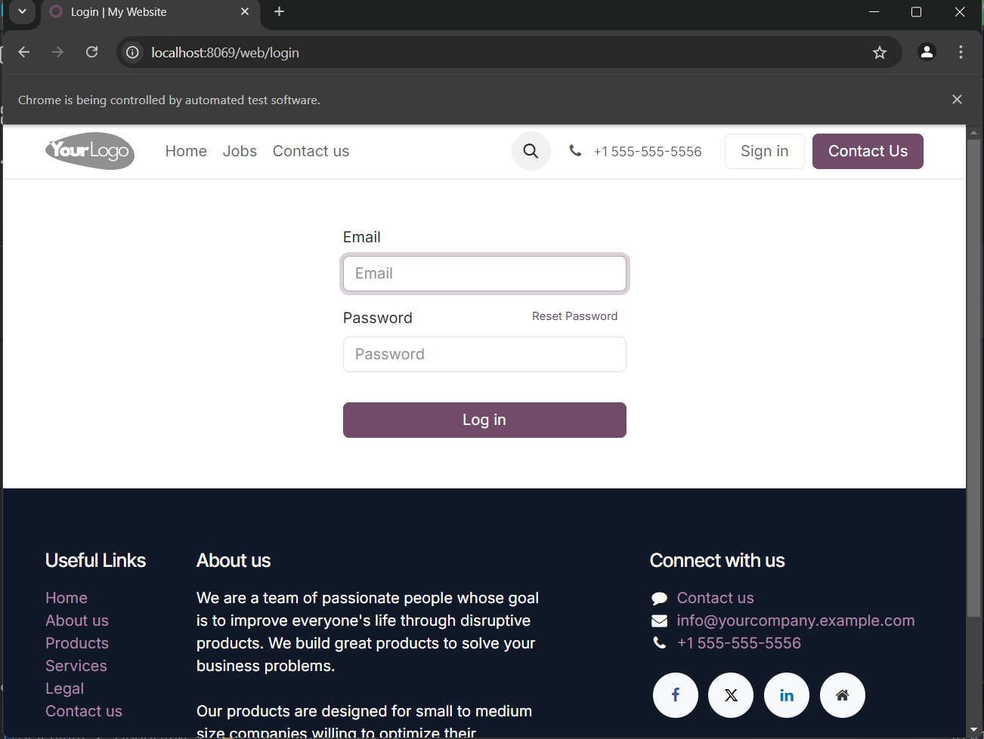
Screenshots of Chrome
Login page being controlled by chrome
After Code Running
After running the code
Command to run code

Slide 14
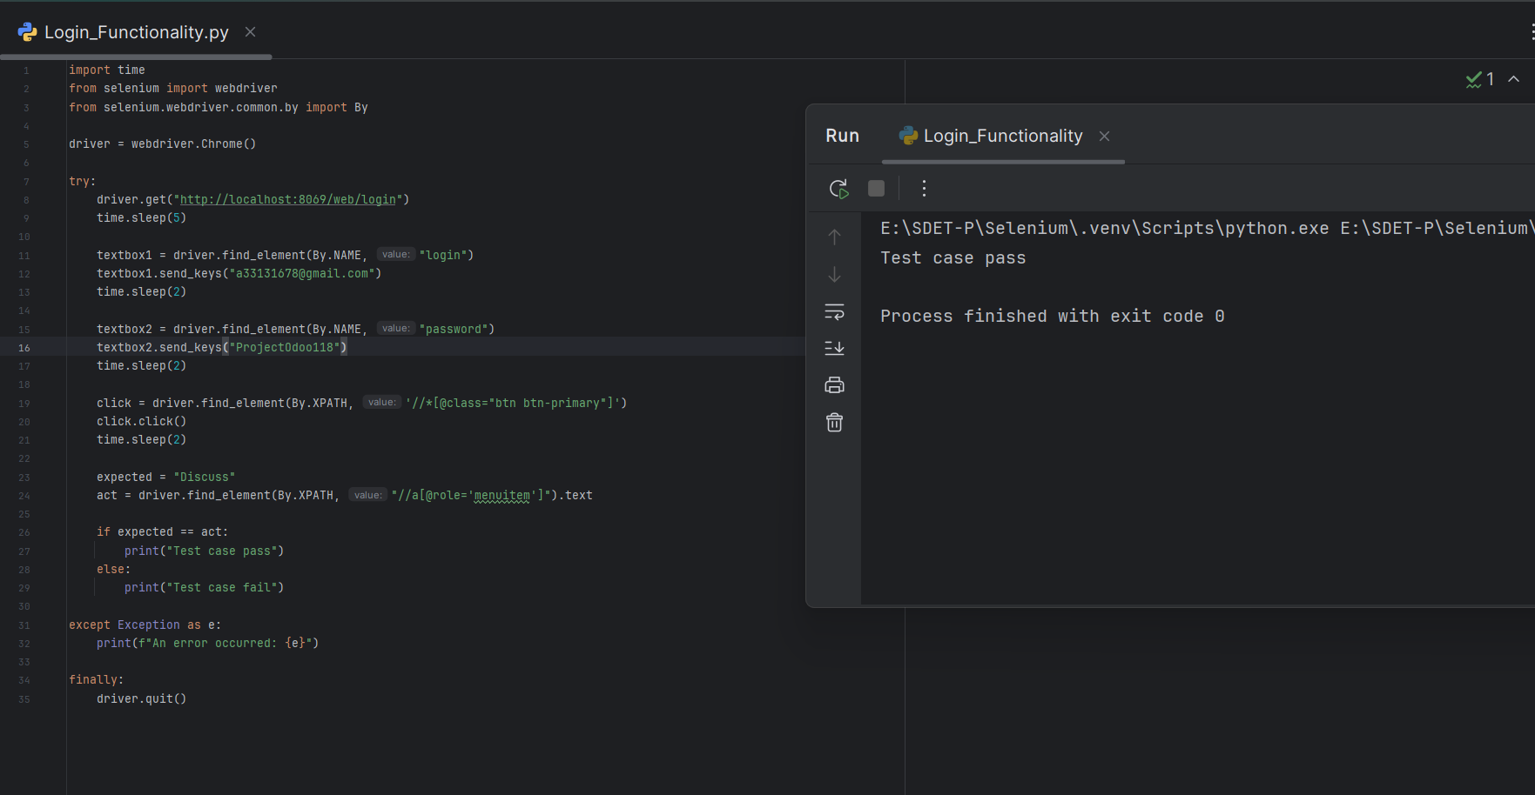
Screenshots of Test Results
Results After validation
Data to be passed to the textbox
Data to be passed to the textbox
Result after Validation
Condition of validation
Condition of validation

Slide 15
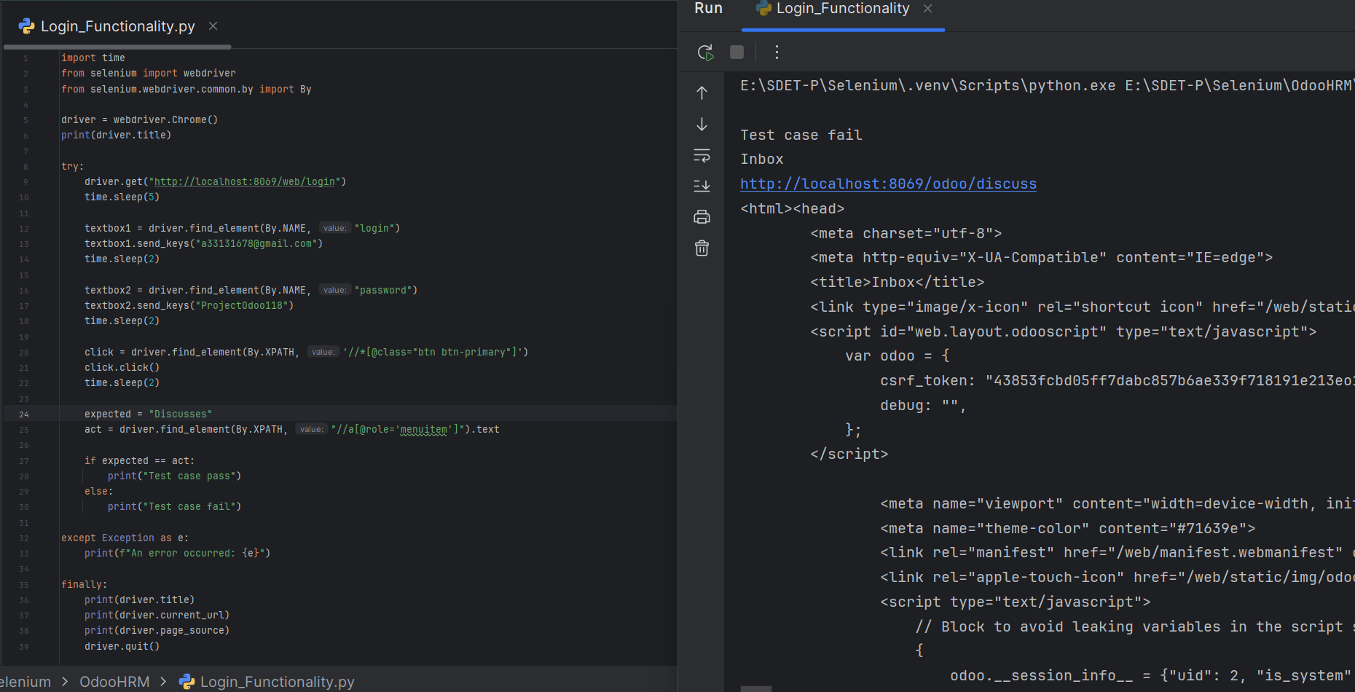
Screenshots of Test Results
Failed Results After validation
Data to be passed to the textbox
Data to be passed to the textbox
Result failed
because expected is not equal to actual
Result on console after validation
If expected doesn’t match with actual
Condition of validation

Slide 16
Conclusion
The Testing process successfully validated the login functionality of the Odoo HRM website hosted at localhost:8069 using Selenium.
Future plans include extending the test coverage to additional features such as Employee Management, Attendance Tracking, and Leave Management.
Integrating data-driven testing will enable dynamic data inputs and facilitate appending results to bug report files, significantly improving the efficiency and comprehensiveness of the testing process.

Slide 17
Thank You

